Slide 1
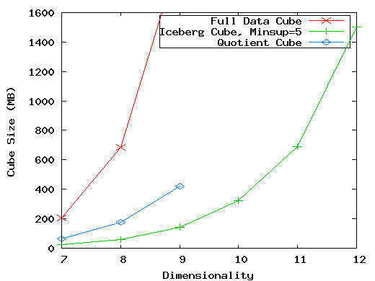
The Curse of Dimensionality
None of the previous cubing method can handle high dimensionality!
A database of 600k tuples. Each dimension has cardinality of 100 and zipf of 2.

Slide 2
Motivation of High-D OLAP
Challenge to current cubing methods:
  The “curse of dimensionality’’ problem
  Iceberg cube and compressed cubes: only delay the inevitable explosion
  Full materialization: still significant overhead in accessing results on disk
High-D OLAP is needed in applications
  Science and engineering analysis
  Bio-data analysis: thousands of genes
  Statistical surveys: hundreds of variables

Slide 3
Fast High-D OLAP with Minimal Cubing
Observation: OLAP occurs only on a small subset of dimensions at a time
Semi-Online Computational Model
  Partition the set of dimensions into shell fragments
  Compute data cubes for each shell fragment while retaining inverted indices or value-list indices
  Given the pre-computed fragment cubes, dynamically compute cube cells of the high-dimensional data cube online

Slide 4
Properties of Proposed Method
Partitions the data vertically
Reduces high-dimensional cube into a set of lower dimensional cubes
Online re-construction of original high-dimensional space
Lossless reduction
Offers tradeoffs between the amount of pre-processing and the speed of online computation

Slide 5
Example Computation
Let the cube aggregation function be count
Divide the 5 dimensions into 2 shell fragments:
  (A, B, C) and (D, E)
tid | A | B | C | D | E
1 | a1 | b1 | c1 | d1 | e1
2 | a1 | b2 | c1 | d2 | e1
3 | a1 | b2 | c1 | d1 | e2
4 | a2 | b1 | c1 | d1 | e2
5 | a2 | b1 | c1 | d1 | e3

Slide 6
1-D Inverted Indices
Build traditional invert index or RID list
Attribute Value | TID List | List Size
a1 | 1 2 3 | 3
a2 | 4 5 | 2
b1 | 1 4 5 | 3
b2 | 2 3 | 2
c1 | 1 2 3 4 5 | 5
d1 | 1 3 4 5 | 4
d2 | 2 | 1
e1 | 1 2 | 2
e2 | 3 4 | 2
e3 | 5 | 1

Slide 7


Shell Fragment Cubes
Generalize the 1-D inverted indices to multi-dimensional ones in the data cube sense
Cell | Intersection | TID List | List Size
a1 b1 | 1 2 3 1 4 5 | 1 | 1
a1 b2 | 1 2 3 2 3 | 2 3 | 2
a2 b1 | 4 5 1 4 5 | 4 5 | 2
a2 b2 | 4 5 2 3 |  | 0

Slide 8
Shell Fragment Cubes (2)
Compute all cuboids for data cubes ABC and DE while retaining the inverted indices
For example, shell fragment cube ABC contains 7 cuboids:
  A, B, C
  AB, AC, BC
  ABC
This completes the offline computation stage

Slide 9
Shell Fragment Cubes (4)
Shell fragments do not have to be disjoint
Fragment groupings can be arbitrary to allow for maximum online performance
  Known common combinations (e.g.,<city, state>) should be grouped together.
Shell fragment sizes can be adjusted for optimal balance between offline and online computation

Slide 10
ID_Measure Table
If measures other than count are present, store in ID_measure table separate from the shell fragments
tid | count | sum
1 | 5 | 70
2 | 3 | 10
3 | 8 | 20
4 | 5 | 40
5 | 2 | 30

Slide 11
The Frag-Shells Algorithm
Partition set of dimension (A₁,…,A_{n}) into a set of k fragments (P₁,…,P_{k}).
Scan base table once and do the following
insert <tid, measure> into ID_measure table.
for each attribute value a_{i} of each dimension A_{i}
build inverted index entry <a_{i}, tidlist>
For each fragment partition P_{i}
build local fragment cube S_{i} by intersecting tid-lists in bottom- up fashion.

Slide 12
Frag-Shells (2)
Dimensions
D Cuboid
EF Cuboid
A | B | C | D | E | F | …
DE Cuboid
Cell | Tuple-ID List
d1 e1 | {1, 3, 8, 9}
d1 e2 | {2, 4, 6, 7}
d2 e1 | {5, 10}
… | …
ABC
Cube
DEF
Cube

Slide 13

Online Query Computation
For example, returns a 2-D data cube.
(a1, b1, c1, * , e1)

Slide 14
Online Query Computation (2)
Given the fragment cubes, process a query as follows
  Divide the query into fragment, same as the shell
  Fetch the corresponding TID list for each fragment from the fragment cube
  Intersect the TID lists from each fragment to construct instantiated base table
  Compute the data cube using the base table with any cubing algorithm

Slide 15
Online Query Computation (3)
A | B | C | D | E | F | G | H | I | J | K | L | M | N | …
Instantiated
Base Table
Online
Cube

